Slide 1

Fraud Detection

Slide 2

We are going to look at a Data set which contains 30 independent variables [float type] & 1 Target variable [int type].
Most of the features have anonymous data except Time , Amount and Class.

Slide 3

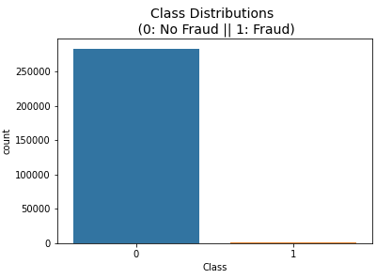
All features V1 thru V28 are already scaled for the sake of anonymity.
75% of Amount have <= $ 78 while 50% and 25% of Amount records have <= $ 22 and $ 6
Class is a Target variable. Its imbalanced with No Fraud [0 type] having 248315 [99.83%] & Fraud [1 type] having 492 [0.17%] records of the dataset.

Slide 4
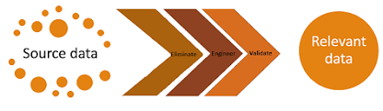
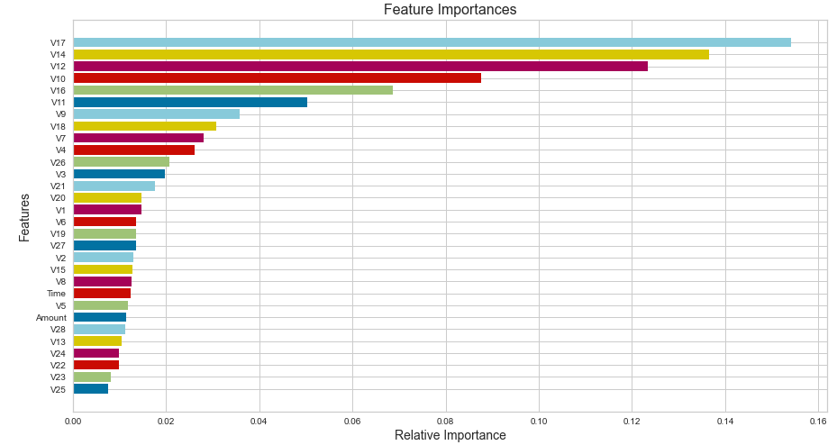
Threshold set : 0.03
Important Features:
V9, V10, V11,
V12, V14, V16, V17

Slide 5
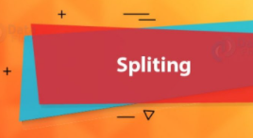

Did a stratified sampling
Before OverSampling, counts of label '1': 378
Before OverSampling, counts of label '0': 226602
After OverSampling, the shape of train_X: (453204, 30)
After OverSampling, the shape of train_y: (453204,)
After OverSampling, counts of label '1': 226602
After OverSampling, counts of label '0': 226602
As I know its imbalanced data set, I did a over sampling technique for Fraud Class. After SMOTE here are the numbers :

Slide 6


Building Model
I tried with different classifiers for raw data and over sampled data.
Decision Tree Classifier
Logistic Regression Classifier
KNN Classifier
Random Forest Classifier
Voting Classifier
Bagging Classifier

Slide 7

Model Evaluation
Below are the different Recall scores for different Classifiers
KNeighborsClassifier 0.42105263157894735
VotingClassifier 0.7789473684210526
LogisticRegression 0.8842105263157894
BaggingClassifier 0.8421052631578947
DecisionTreeClassifier 0.7052631578947368

Slide 8


I analysed the characteristics and distribution of data in brief.
I investigated in-depth the features which to retain and which to discard.
I performed model development by using an ensemble technique of a variety of algorithms.
I observed better results as we started experimenting with different classifiers.
This model will help the company in saving lot of resources with better recall score of 0.88 where there is less False Positives.

